Slide 1
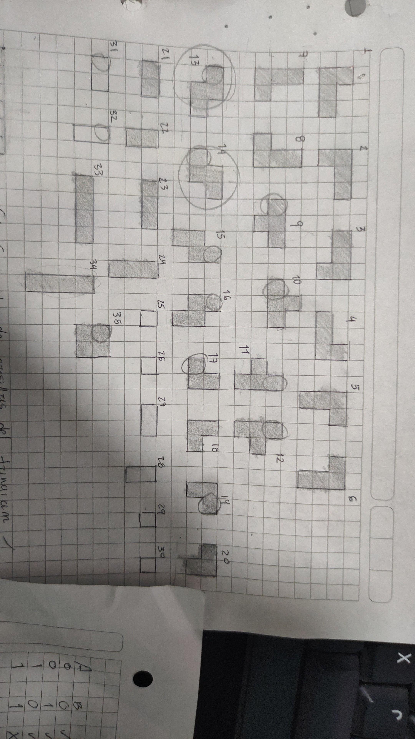
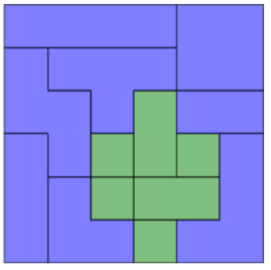
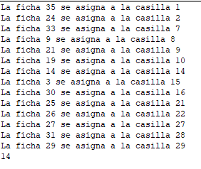
X(i,j): coloco o no la ficha i en la casilla j.
Y(j): la casilla j esta ocupada.
d(j): color deseado para la casilla j. 1 si azul, 2 si verde.
p(i): color de la figura i.
Hacer una restricción de igualdad cuando se asigna y que se elimine cuando no se asigna.
D(15)=p(20)*x(20,15)
d(15)+d(16)+d(22) <= P(20)*x(20,15)
(1-x(20,15))
1 | 2 | 3 | 4 | 5 | 6
7 | 8 | 9 | 10 | 11 | 12
13 | 14 | 15 | 16 | 17 | 18
19 | 20 | 21 | 22 | 23 | 24
25 | 26 | 27 | 28 | 29 | 30
31 | 32 | 33 | 34 | 35 | 36
1 | 2 | 3 | 4 | 5 | 6
7 | 8 | 9 | 10 | 11 | 12
13 | 14 | 15 | 16 | 17 | 18
19 | 20 | 21 | 22 | 23 | 24
25 | 26 | 27 | 28 | 29 | 30
31 | 32 | 33 | 34 | 35 | 36

Slide 2
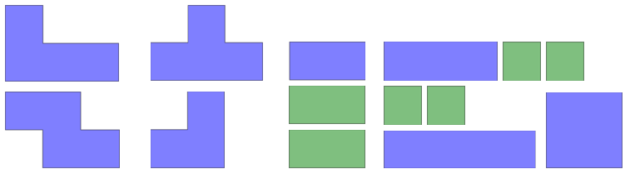

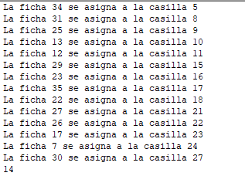
d(33)+d(34)+d(28) +d(29) -4*x(14,33)*p(20) = 0
1+(2x3)=7 - 4
1 | 2 | 3 | 4 | 5 | 6
7 | 8 | 9 | 10 | 11 | 12
13 | 14 | 15 | 16 | 17 | 18
19 | 20 | 21 | 22 | 23 | 24
25 | 26 | 27 | 28 | 29 | 30
31 | 32 | 33 | 34 | 35 | 36
1 | 2 | 3 | 4 | 5 | 6
7 | 8 | 9 | 10 | 11 | 12
13 | 14 | 15 | 16 | 17 | 18
19 | 20 | 21 | 22 | 23 | 24
25 | 26 | 27 | 28 | 29 | 30
31 | 32 | 33 | 34 | 35 | 36

Slide 3
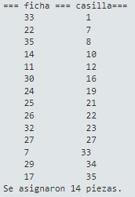
1 | 2 | 3 | 4 | 5 | 6
7 | 8 | 9 | 10 | 11 | 12
13 | 14 | 15 | 16 | 17 | 18
19 | 20 | 21 | 22 | 23 | 24
25 | 26 | 27 | 28 | 29 | 30
31 | 32 | 33 | 34 | 35 | 36
1 | 2 | 3 | 4 | 5 | 6
7 | 8 | 9 | 10 | 11 | 12
13 | 14 | 15 | 16 | 17 | 18
19 | 20 | 21 | 22 | 23 | 24
25 | 26 | 27 | 28 | 29 | 30
31 | 32 | 33 | 34 | 35 | 36

Slide 4
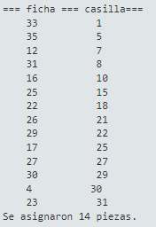
1 | 2 | 3 | 4 | 5 | 6
7 | 8 | 9 | 10 | 11 | 12
13 | 14 | 15 | 16 | 17 | 18
19 | 20 | 21 | 22 | 23 | 24
25 | 26 | 27 | 28 | 29 | 30
31 | 32 | 33 | 34 | 35 | 36
1 | 2 | 3 | 4 | 5 | 6
7 | 8 | 9 | 10 | 11 | 12
13 | 14 | 15 | 16 | 17 | 18
19 | 20 | 21 | 22 | 23 | 24
25 | 26 | 27 | 28 | 29 | 30
31 | 32 | 33 | 34 | 35 | 36

Slide 5
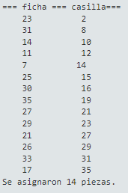

1 | 2 | 3 | 4 | 5 | 6
7 | 8 | 9 | 10 | 11 | 12
13 | 14 | 15 | 16 | 17 | 18
19 | 20 | 21 | 22 | 23 | 24
25 | 26 | 27 | 28 | 29 | 30
31 | 32 | 33 | 34 | 35 | 36
1 | 2 | 3 | 4 | 5 | 6
7 | 8 | 9 | 10 | 11 | 12
13 | 14 | 15 | 16 | 17 | 18
19 | 20 | 21 | 22 | 23 | 24
25 | 26 | 27 | 28 | 29 | 30
31 | 32 | 33 | 34 | 35 | 36

Slide 6
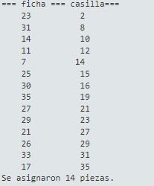
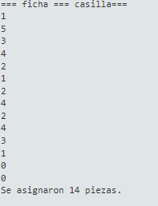
1
1 | 2 | 3 | 4 | 5 | 6
7 | 8 | 9 | 10 | 11 | 12
13 | 14 | 15 | 16 | 17 | 18
19 | 20 | 21 | 22 | 23 | 24
25 | 26 | 27 | 28 | 29 | 30
31 | 32 | 33 | 34 | 35 | 36

